Slide 1
Welcome to VENDOR TRAINING

Slide 2
introduction
the operating room / PROCEDURE ROOMS is a highly restricted area that is subject to many laws, regulations, and professional guidelines.
it is important for you to understand how to work in and around this unique environment.
This training will provide you with the information you will need to successfully and safely fulfill your responsibilities in the OR/procedure room, while protecting yourself and the safety and rights of OUR patients and staff. Following the suggestions in this program will also help you build rapport with the OR team, which in turn can result in becoming an important source of technical support for you and your product.

Slide 3
OBJECTIVES
Upon completion of this online activity, the participant should be able to
Identify the appropriate attire to wear in the or
EXPLAIN the importance of hand hygiene
Describe techniques to minimize the risk of infection in the intraoperative environment.
Interpret the principles of aseptic practices and follow them in specific OR scenarios.
Identify the steps required if you are involved in a blood borne exposure incident.
Summarize the roles VENDORS might assume in the OR to ensure compliance with policies and maintain positive working relationships.
Identify mechanisms the VENDOR can use to ensure the smooth introduction of products, equipment or instrumentation in the operating room.

Slide 4
HIPAA
The vendor is required to follow all privacy rules, and that means they have to understand HIPAA and how it can be violated
Vendors will be familiar with MISH HIPAA policy – part of application process
Vendors will be asked to sign a “vendor confidentiality agreement” – via application process
A vendor routinely should not need access to patient medical history or record
A vendor needs patient consent to be able to enter the patient operating room/case
obvious restrictions:
Consent prior to entrance in the OR with patient
no video cameras or photographs
No audio recordings
No patient records may leave hospital premises without approval
No patient information can be released in a conversation, as a text, fax, or a photocopy
No direct patient care may be provided

Slide 5
Basic CODE of conduct
All vendors must complete an application and be verified
All vendors must wear a vendor tag while on premises
vendor must disinfect any equipment not requiring sterilization that a vendor brings into the OR. Ask or staff to assist to ensure proper disinfection of equipment is completed prior to use
Literature must be provided for the proper processing of instruments. No instrument is to be put in use until the instrument-processing technician has reviewed the process.
Any electrical equipment requires a biomedical electrical safety check, within the last 12 months. Documentation is required. The equipment can not be used unless documentation available.
Vendors must ensure consent was obtained from the patient for he/she to enter the operating room.
Vendors should wait in the lobby till OR staff or case is ready
Vendors needing to set up prior to the case start must do so with staff present at all times.
vendors may not be permitted to participate directly in patient care, touching the patient, or any procedures on the patient.

Slide 6
Basic code of conduct
The vendor is present as an advisor to the perioperative team to ensure the safe and effective application of surgical devices and technologies
The vendor should be present at the request of the operating surgeon
The patient should be informed of the presence and purpose of the vendor in the OR and give written, informed consent. This should be documented within the medical records.
Vendor Should not engage in the practice of surgery, nursing or medical decision making
Vendor Should not scrub or be involved in direct patient contact
May be involved in the remote calibration or adjustment of medical devices to the surgeons and manufacturers’ specifications (e.g. pacemakers, pain pumps, defibrilators…)
Vendor will have his or her activities monitored and supported by the surgeon (or, at the surgeon’s discretion) and the perioperative nurse responsible for the patient’s care to ensure compliance with policy and procedure

Slide 7
Basic code of conduct
wandering throughout the department, or from room to room, or throughout the facility is prohibited
conducting unauthorized selling, marketing, or lobbying is prohibited
vendors are prohibited from scrubbing, performing circulating duties, and serving as an extra body for opening sterile or unsterile supplies or tying gowns
During patient care / surgery Vendors are restricted to provide information and instruction verbally only.

Slide 8
Basic code of conduct
Please Contact only those personnel or departments for which prior authorization was given. Attempting to circumvent the department’s contact would be prohibited
personal or sales/marketing calls should not be made on department telephones.
Please Keep conversation/noise level to a minimum.
aggressiveness, harassing, abusive, vulgar behavior or language is prohibited
disruptive or distracting behavior in the or is disruptive to the or flow and linked with increased complications

Slide 9
Basic code of conduct
The vendor could be required to leave the area immediately, when told to do so. Some reasons may include: an emergent situation, interference with the procedure, or not complying with instructions.
Access to patient medical records requires permission from circulating rn.
Vendors could be denied access to specific or aggregate patient information beyond that of the case for which the patient has consented. Specifically, if Such information is limited to a need-to-know clinical level.
If vendor violates the code of conduct, the circulating nurse can use the established chain of command:
First, the vendor can be asked to stop the behavior.
If the behavior continues, the circulating nurse can notify the surgeon.
If this does not resolve the issue, the nurse can contact the or supervisor for administrative assistance to address the behavior.

Slide 10
OPERATING ROOM (OR) ETIQUETTE
Vendors must wear a “vendor tag”
Vendors must be in full surgical attire to enter the or suite area
Vendors must be attended by or staff at all times in the or suite
Vendors cannot enter/stay in the or without perioperative staff
Always be aware of your presence relative to sterile field/staff- know what and who is sterile
Stay away from the sterile field/sterile personnel as much as possible
Minimize movement – please stay in the area designated by the circulating rn
When approaching the sterile field maintain distance and ask permission of circulating RN to do so. The RN will guide the vendor to ensure sterile field is not contaminated
The circulating RN is in charge of the room – direct questions or concerns to him/her

Slide 11
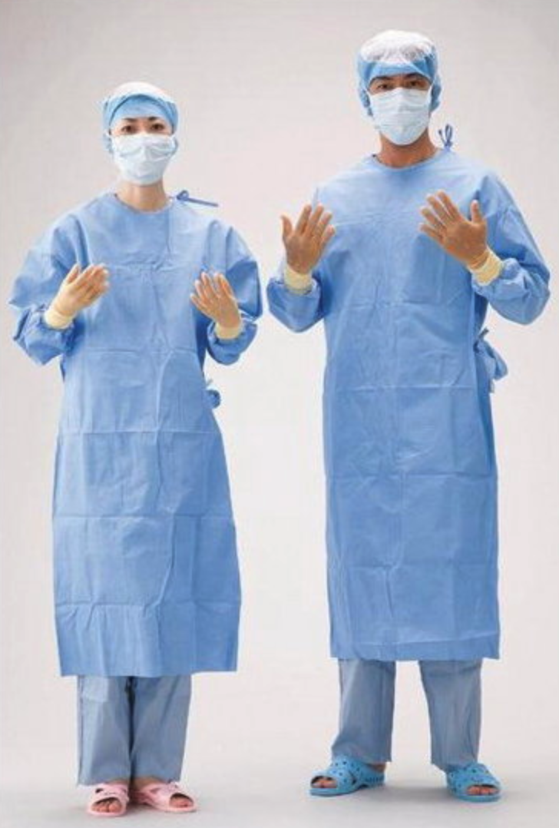
Clean – aseptic - sterile

Slide 12
COVID-19
Complete the registration check-in with each visit (COVID screening questions and Temp check)
A face mask is required while on hospital premises at all times
Perform frequent Hand Hygiene (sanitizer or disinfectant)
Hand hygiene at a minimum is performed:
before and after any patient care (direct or indirect)
Before and after entering a patient room or care area.

Slide 13
ASEPTIC TECHNIQUE
A method of performing a procedure as sterily as possible without being in an or room
Requires the use of various barriers to prevent the transfer of microorganisms from health care personnel and the environment to the patient during a procedure, by using barriers such as:
Sterile gloves, gowns, Sterile drapes, Masks
Antiseptic skin preparation of the patient at the time of the procedure, Sterile instruments, Sterile equipment, Sterile devices
Only sterile-to-sterile contact is allowed; sterile-to-nonsterile contact must be avoided.

Slide 14
Sterile technique requires
Sterile means free of germs. For a procedure to be considered sterile the people and equipment/supplies used must be sterile in a dedicated disinfected area, and anything interacting with the sterile field must be sterile as well. Sterile technique requires:
A dedicated room – high level of cleanliness/disinfection
Hair cap and mask
Sterile hand wash
Sterile operative field, supplies, instruments
Sterile gown, gloves
Sterile prep
Maintenance of sterile field, staff, instruments and supplies

Slide 15
Sterile Field(s)
Sterile field: The or table and any table/surface on which sterile instruments/equipment are open are considered sterile
Sterile Staff: The surgeon, assistants and srcub techs are considered sterile
Non-sterile staff: anesthesia, circulating rn, rad tech, vendor, visitors
Only sterile staff can touch sterile fields/areas
Any non-sterile staff must keep a 2-3ft distance/space between themselves and sterile staff and sterile fields/tables
When passing by a sterile field or person - always face them-keep them in site and keep a safe distance to avoid touching anything sterile (touching = contamination)

Slide 16
STERILE FIELD(s)
Only sterile items-supplies can be put on a sterile field
Only Sterile staff can touch sterile things
Sterile staff work only in a sterile field
Non-sterile staff can not touch sterile staff or sterile field
If a sterile field/staff is contaminated the team must be informed immediately

Slide 17
Sterile packages / supplies / instruments
Only an or rn may open sterile packages / supplies
Only an or rn interacts with sterile staff and sterile field
If a vendor needs to approach the sterile field he/she needs permission to approach from circulating rn – the rn will ensure the vendor is safely moving near the sterile field/staff.
All equipment brought into the room must be disinfected prior to entry.
All sterile supplies/packages/instruments are inspected for integrity, sterility and expiration dates prior to opening/using

Slide 18
SURGICAL ATTIRE
Vendors and visitors must be in surgical attire to enter OR suite area
Basic Surgical attire consists of:
Hair cap
Mask
Mish surgical scrubs
If will not be wearing surgical scrubs must wear a gown covering clothing. Scrubs preferred.
Shoe covers
Prior to entering the or suite, hand hygiene is performed
After leaving the or suite; mask, and shoe covers are discarded in regular trash

Slide 19
UNIVERSAL PRECAUTIONS
OSHA definition: treat all human blood and body fluids as if they contain bloodborne pathogens. Bloodborne pathogens are microorganisms found in human blood that can cause disease.
ASSUME ALL body fluids are contaminated (blood, urine, sputum……)
Handle all body fluids as if they are contaminated
As a vendor do not touch body fluids
All body fluids / tissues are disposed of in red biohazardous waste bags
If a vendor or visitor touch any body fluids - please immediately inform the circulating rn
To minimize exposure everyone must where universal precautions or protective barriers such as:
Gloves, face shields, eye goggles, face mask
Wash hands before and after wearing gloves
Wash hands before and after patient contact

Slide 20
UNIVERSAL PRECAUTIONS
Body fluids / tissue are considered biohazardous waste and should be disposed of in red biohazardous bags or biohazardous labeled containers.
Methods of contact:
Direct contact. Infected blood or body fluid from one person enters another person’s body at a correct entry site, such as infected blood splashing in the eye.
Indirect contact. A person’s skin touches an object that contains the blood or body fluid of an infected person, such as picking up soiled dressings contaminated with an infected person’s blood or body fluid.
Respiratory droplet transmission. A person inhales droplets from an infected person, such as through a cough or sneeze.
Vector-borne transmission. A person’s skin is penetrated by an infectious source, such as an insect bite.

Slide 21
Protection - BLOOD BORNE PATHOGENS
Universal precautions are always used when handling body fluids, and tissues
All body fluids / tissues are assumed to be carriers of blood borne pathogens
Blood borne pathogens – are organisms found in body fluids / tissues that can carry/cause disease
In healthcare the more common and dangerous carriers of diseases are: HIV, Hepatitis B, Hepatitis C, MRSA, VRE and Tuberculosis
By using universal precautions when handling/disposing of bodily fluids/tissues you can significantly reduce your risk/spread of infection

Slide 22
Infection control policies
The purpose of sterility and aseptic technique is to minimize micro-organism cross-contaminating into the operative site and thus cause infection. Bacteria/viruses cause infection.
Hand hygiene is required before and after entering a patient care area to minimize spread of organisms
Hand hygiene is required before and after patient contact
Vendor equipment must be disinfected before and after use in patient care areas
Vendor Equipment must be disinfected before bringing it into the operating room and when removing from the or
Surgical attire must be worn: mish scrubs, mask, gloves, shoe cover
Sterility and aseptic technique must be maintained to minimize infection risk

Slide 23
Hand hygiene
Hand hygiene is our most important infection control prevention measure
Hands are the most common and easiest way to spread infectious organisms
Wash or disinfect hands before and after entering a patient care area
Wash or disinfect hands before entering and leaving the operating room
Wash or disinfect your hands after done handling equipment
Hand sanitizers are available for your use on the walls.
There are on average 1-2 dispensers in each patient care area.
Sinks are available in bathrooms and operating room for washing

Slide 24
Hand washing technique

Slide 25
Hand sanitizer use INSTRUCTIONS

Slide 26
Radiation safety
The radiology technician will ask non-essential staff to leave the or when x-rays are being obtained (safest way to reduce radiation exposure is leave the area)
We recommend vendors leave the room when radiation equipment is used
If a vendor needs to be in the or they must wear a lead apron. To further reduce exposure risk stay as far from the x-ray machine as possible, and only stay as long as necessary.
The apron must face the x-ray machine for maximum barrier protection
3 principles of radiation safety:
Distance – the further from the source the less radiation exposure
Time – the shorter the exposure the less radiation exposure
Shielding – lead aprons are barriers against radiation

Slide 27
Fire and electrical safety
Fire extinguishers – a fire extinguisher is available in the OR hall, and in pre-op
Fire alarms – are available to activate the fire alarm system in case of a fire
Fire exits – the closest fire exit is from pre-op to the lobby, next closest is from pre-op thru PACU. Please look on the walls for the fire emergency map showing you the closest exits from a specific location in the hospital
All electrical equipment must pass a biomedical electric safety check prior to use including vendor electrical equipment
In case of a Fire - RACE | Using an Extinguisher - PASS
Rescue | Pull
Alarm | Aim
Confine | Squeeze
Extinguish | Sweep

Slide 28
Other emergency procedures
In each patient care area on the wall there are emergency procedure posters posted for easy access in case of an emergency
Each poster contains information about what to do for the most common emergencies that may arise at MISH:
Code black – bomb threat
Code Blue – Unresponsive patient
Code pink – child abduction
Code red – fire
code graY – severe weather
Hazardous – biohazardous spill (blood)
Code orange – catastrophic emergency
Code 13 – belligerent/combatative person
Code silver - shooter

