Slide 1
Welcome to HealthCare Provider TRAINING

Slide 2
introduction
This training will provide you with the information you will need to successfully and safely fulfill your responsibilities in the hospital environment, while protecting yourself and the safety and rights of OUR patients and staff. Following the suggestions in this program will also help you build rapport with the medical staff team

Slide 3
OBJECTIVES
Upon completion of this online activity, the participant should be able to:
EXPLAIN the importance of hand hygiene and infection control measures
Understand the importance and purpose of HIPAA
Accurately and correctly perform documentation of provided patient care services
Identify the steps required if you are involved in a blood borne exposure incident.
Summarize the roles VENDORS might assume in the OR to ensure compliance with policies and maintain positive working relationships.

Slide 4
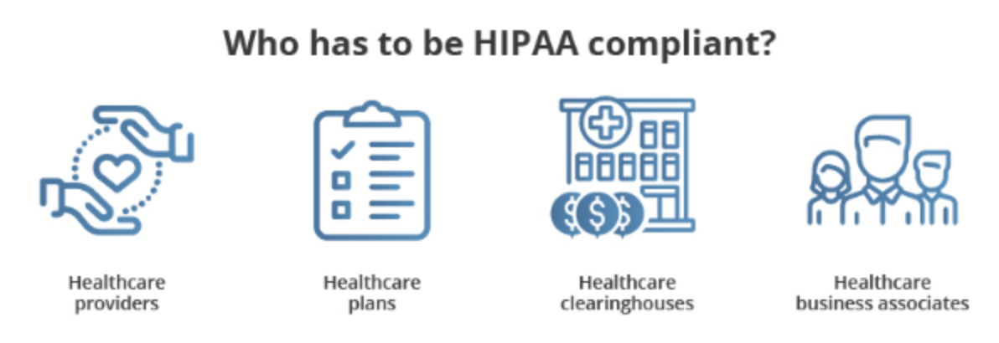
HIPAA
HealthCare providers (HCP) are required to follow all privacy rules, and that means they have to understand HIPAA and how it can be violated
HealthCare providers (HCP) will be familiar with MISH HIPAA policy – part of application process
HealthCare providers (HCP) will be asked to sign a “vendor confidentiality agreement” – via application process
HealthCare providers (HCP) routinely should not need access to a patient medical history or record, if required please communicate with RN taking care of patient
obvious restrictions:
no video cameras or photographs
No audio recordings
No patient records may leave hospital premises without approval
No patient information can be released in a conversation, as a text, fax, or a photocopy

Slide 5
DOCUMENTATION
Always identify patient and patient record with 2 patient identifiers (Name and DOB)
Always document patient name and DOB on each paper record
Always document your name, time and date on any documentation being completed by you
Verify with the nurse caring for the patient whether there are dedicated forms that may be used to document your services, if not a Progress note may be used.

Slide 6
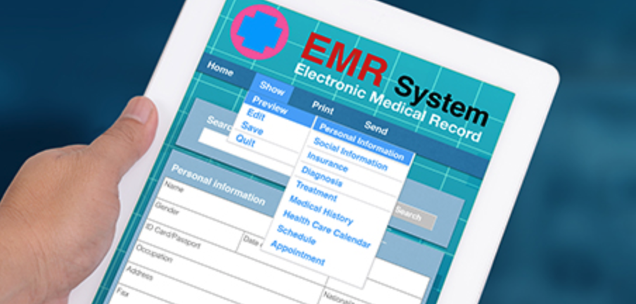
Medical Record
A large part of the medical record is paper.
For Parts that are in an electronic medical record – you will need to ask the nurse caring for the patient to provide you with any needed documents, labs, tests or reports to be able to complete your patient assessment and/or provide patient care service.

Slide 7
Basic CODE of conduct
All HealthCare providers (HCP) must complete an application and be verified
All HCP’s must wear a HCP tag while on premises
HCP must disinfect any equipment/Instrumentation prior to use or entry into a patient care area.
Any electrical equipment requires a biomedical electrical safety check, within the last 12 months. Documentation is required. The equipment can not be used unless documentation available.
HCP’s must ensure consent was obtained from the patient for he/she to provide any patient care that requires consent

Slide 8
Basic code of conduct
The patient should be informed of the purpose of your visit.
Patient questions should be answered to their satisfaction

Slide 9
Basic code of conduct
wandering throughout the department, or throughout the facility is prohibited
conducting unauthorized selling, marketing, or lobbying is prohibited

Slide 10
Basic code of conduct
Please Keep conversation/noise level to a minimum.
aggressiveness, harassing, abusive, vulgar behavior or language is prohibited
disruptive or distracting behavior in the facility is disruptive to the flow of patient care

Slide 11
Basic code of conduct
The HealthCare Provider (HCP) could be required to leave the area immediately, when told to do so. Some reasons may include: an emergent situation, or not complying with the code of conduct or state/federal regulations
HCP’s could be denied access to specific or aggregate patient information beyond that of the scope of their practice. Specifically, if Such information is limited to a need-to-know basis.
If HCP violates the code of conduct, the nurse can use the established chain of command:
First, the HCP can be asked to stop the behavior.
If the behavior continues, the nurse can notify the DON
If this does not resolve the issue, the nurse can contact administrative assistance to address the behavior.

Slide 12
COVID-19
Complete the registration check in with each visit (COVID screening questions and Temp check)
A face mask is required while on hospital premises at all times
Perform frequent Hand Hygiene (sanitizer or disinfectant)
Hand hygiene at a minimum is performed:
before and after any patient care (direct or indirect)
Before and after entering a patient room or care area.

Slide 13
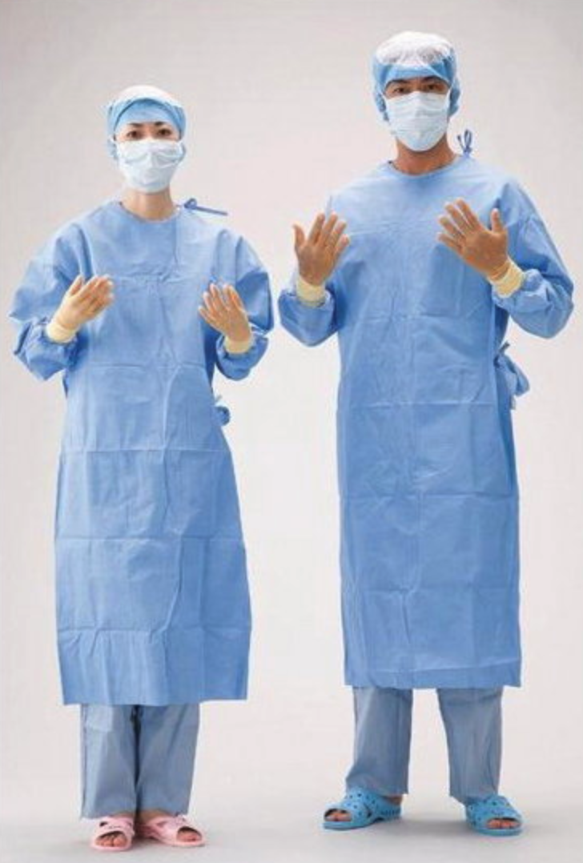
Clean – aseptic - sterile

Slide 14
ASEPTIC TECHNIQUE
A method of performing a procedure as aseptically (sterile) as possible without being in an or room
Requires the use of various barriers to prevent the transfer of microorganisms from health care personnel and the environment to the patient during a procedure, by using barriers such as:
Sterile gloves, gowns, Sterile drapes, Masks
Antiseptic skin preparation of the patient at the time of the procedure, Sterile instruments, Sterile equipment, Sterile devices
Only sterile-to-sterile contact is allowed; sterile-to-nonsterile contact must be avoided.

Slide 15
Sterile Field(s)
Sterile field: The or table and any table/surface on which sterile instruments/equipment are open are considered sterile
Sterile Staff: The surgeon, assistants and srcub techs are considered sterile
Non-sterile staff: anesthesia, circulating rn, rad tech, vendor, visitors
Only sterile staff can touch sterile fields/areas
Any non-sterile staff must keep a 2-3ft distance/space between themselves and sterile staff and sterile fields/tables
When passing by a sterile field or person - always face them-keep them in site and keep a safe distance to avoid touching anything sterile (touching = contamination)

Slide 16
STERILE FIELD(s)
Only sterile items-supplies can be put on a sterile field
Only Sterile staff can touch sterile things
Sterile staff work only in a sterile field
Non-sterile staff can not touch sterile staff or sterile field
If a sterile field/staff is contaminated the team must be informed immediately

Slide 17
ASeptic ATTIRE
HCP must wear minimum PPE
Basic aseptic attire consists of:
Hair cap
Mask
Gloves (sterile or non-sterile)
Prior to starting a procedure, hand hygiene is performed
After completing the procedure; PPE is discarded in regular trash

Slide 18
UNIVERSAL PRECAUTIONS
OSHA definition: treat all human blood and body fluids as if they contain bloodborne pathogens. Bloodborne pathogens are microorganisms found in human blood that can cause disease.
ASSUME ALL body fluids are contaminated (blood, urine, sputum……)
Handle all body fluids as if they are contaminated
As a vendor do not touch body fluids
All body fluids / tissues are disposed of in red biohazardous waste bags
If a vendor or visitor touch any body fluids - please immediately inform the circulating rn
To minimize exposure everyone must where universal precautions or protective barriers such as:
Gloves, face shields, eye goggles, face mask
Wash hands before and after wearing gloves
Wash hands before and after patient contact

Slide 19
UNIVERSAL PRECAUTIONS
Body fluids / tissue are considered biohazardous waste and should be disposed of in red biohazardous bags or biohazardous labeled containers.
Methods of contact:
Direct contact. Infected blood or body fluid from one person enters another person’s body at a correct entry site, such as infected blood splashing in the eye.
Indirect contact. A person’s skin touches an object that contains the blood or body fluid of an infected person, such as picking up soiled dressings contaminated with an infected person’s blood or body fluid.
Respiratory droplet transmission. A person inhales droplets from an infected person, such as through a cough or sneeze.
Vector-borne transmission. A person’s skin is penetrated by an infectious source, such as an insect bite.

Slide 20
Protection - BLOOD BORNE PATHOGENS
Universal precautions are always used when handling body fluids, and tissues
All body fluids / tissues are assumed to be carriers of blood borne pathogens
Blood borne pathogens – are organisms found in body fluids / tissues that can carry/cause disease
In healthcare the more common and dangerous carriers of diseases are: HIV, Hepatitis B, Hepatitis C, MRSA, VRE and Tuberculosis
By using universal precautions when handling/disposing of bodily fluids/tissues you can significantly reduce your risk/spread of infection

Slide 21
Infection control policies
The purpose of sterility and aseptic technique is to minimize micro-organism cross-contaminating into the operative site and thus cause infection. Bacteria/viruses cause infection.
Hand hygiene is required before and after entering a patient care area to minimize spread of organisms
Hand hygiene is required before and after patient contact
HCP equipment must be disinfected before and after use in patient care areas
HCP Equipment must be disinfected before bringing it into the patient room / care area and when removing it from the patient room / care area and when
aseptic technique must be maintained to minimize infection risk

Slide 22
Hand hygiene
Hand hygiene is our most important infection control prevention measure
Hands are the most common and easiest way to spread infectious organisms
Wash or disinfect hands before and after entering a patient care area
Wash or disinfect hands before entering and leaving the operating room
Wash or disinfect your hands after done handling equipment
Hand sanitizers are available for your use on the walls.
There are on average 1-2 dispensers in each patient care area.
Sinks are available in bathrooms and operating room for washing

Slide 23
Hand washing technique

Slide 24
Hand sanitizer use INSTRUCTIONS

Slide 25
Radiation safety
The radiology technician will ask non-essential staff to leave a room when x-rays are being obtained (safest way to reduce radiation exposure is leave the area)
We recommend HCP’s leave the room when radiation equipment is used
If a HCP needs to be in the room they must wear a lead apron. To further reduce exposure risk stay as far from the x-ray machine as possible, and only stay as long as necessary.
The apron must face the x-ray machine for maximum barrier protection
3 principles of radiation safety:
Distance – the further from the source the less radiation exposure
Time – the shorter the exposure the less radiation exposure
Shielding – lead aprons are barriers against radiation

Slide 26
Fire and electrical safety
In case of a Fire - RACE | Using an Extinguisher - PASS
Rescue | Pull
Alarm | Aim
Confine | Squeeze
Extinguish | Sweep
Fire extinguishers – a fire extinguisher is available in your area
Fire alarms – are available to activate the fire alarm system in case of a fire
Fire exits – Locate the closest fire exit
Please look on the walls for the fire emergency map showing you the closest exits from a specific location in the hospital
All electrical equipment must pass a biomedical electric safety check prior to use including HCP electrical equipment

Slide 27
Other emergency procedures
In each patient care area on the wall there are emergency procedure posters posted for easy access in case of an emergency
Each poster contains information about what to do for the most common emergencies that may arise at MISH:
Code black – bomb threat
Code Blue – Unresponsive patient
Code pink – child abduction
Code red – fire
code graY – severe weather
Hazardous – biohazardous spill (blood)
Code orange – catastrophic emergency
Code 13 – belligerent/combative person
Code silver - shooter

